Slide 1
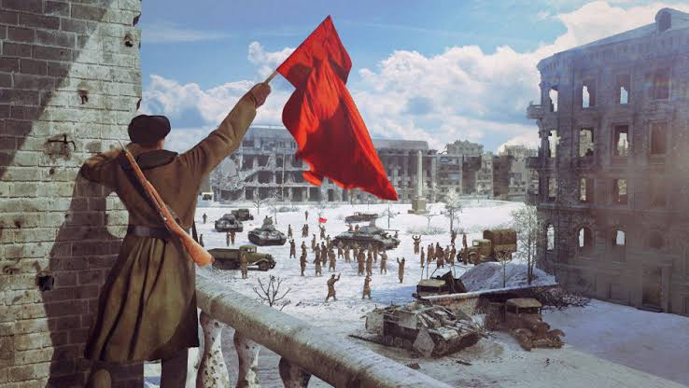
Battle of Stalingrad
THE WAR THAT CHANGED THE COURSE OF HISTORY.

Slide 2
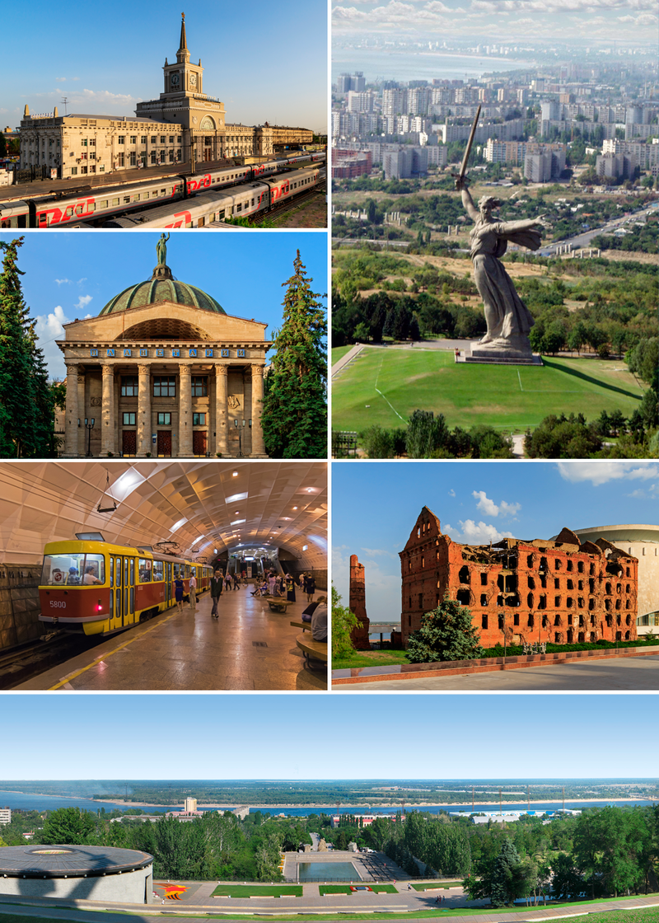
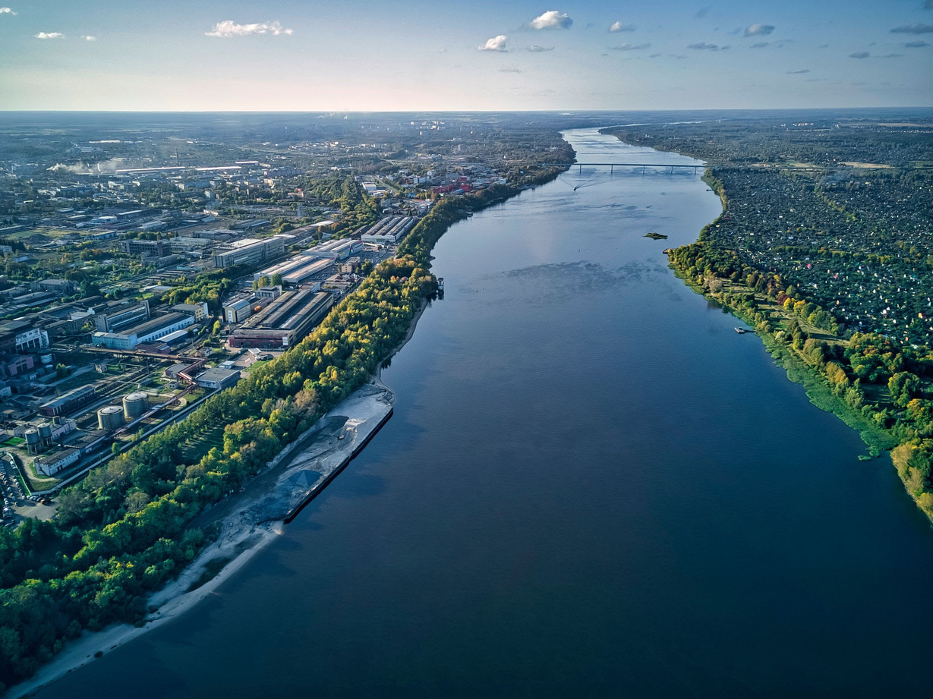
Stalingrad Today,
Today name of the Stalingrad is Volgograd Oblast.
The name of the city changed in 1961.
The city is on the edge of Idyll River.
It's an industrial area.
It is the city with the best transportation in the country.
Volga (Idyll) River

Slide 3
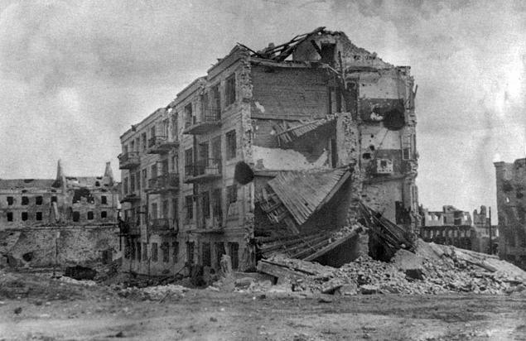
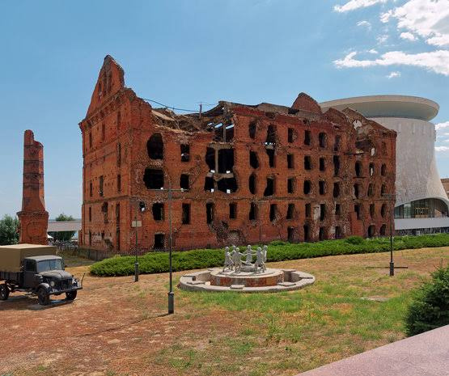
One more thing about Stalingrad
Pavlov's house
This building is very important for the Russian.During the Battle of Stalingrad, Sergeant Yakov Pavlov and his command resisted in this building for months. And he defeats the Germans.

Slide 4
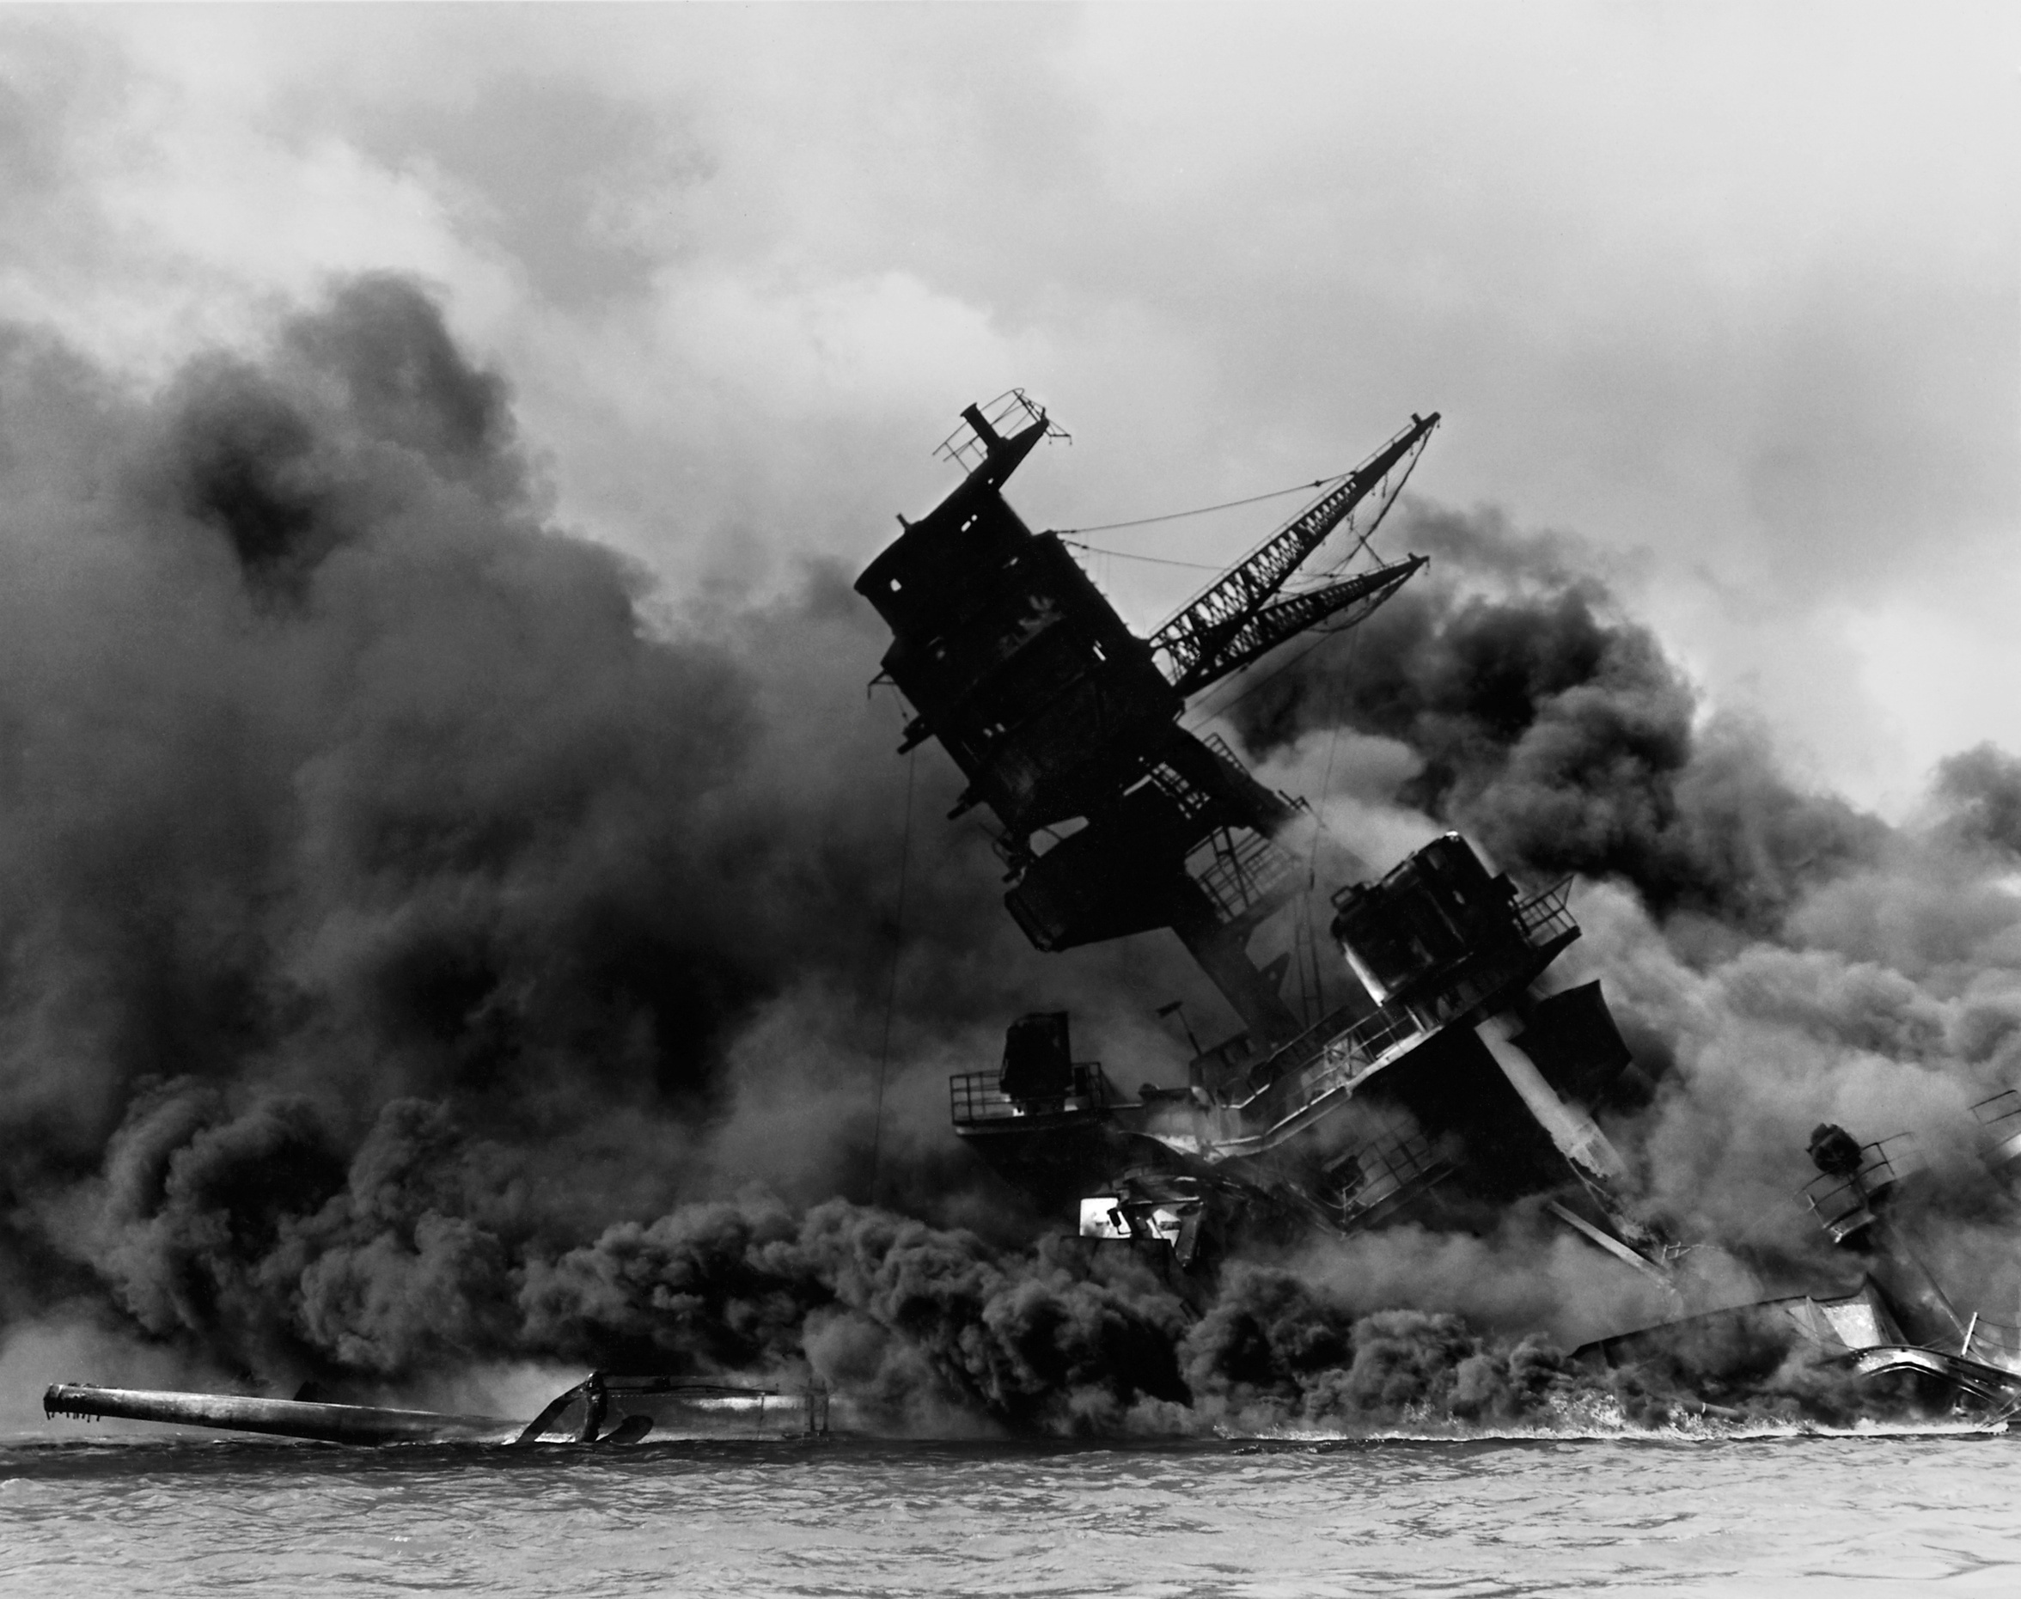
Belligerents

Slide 5
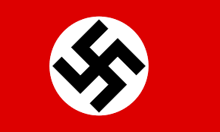



Nazi Germany
Germany from the Axis Powers.
Adolf Hitler is command of the Germany.
Army Group is B.
Romania, Italy joined the war on the side of Germany.
Luftwaffe and Wehrmacht is power of the Germany.
Luftwaffe = Air Force /// Wehrmacht = Armed Forces
Friedrich Paulus is command of the 6.Army.
Romania
Italy

Slide 6
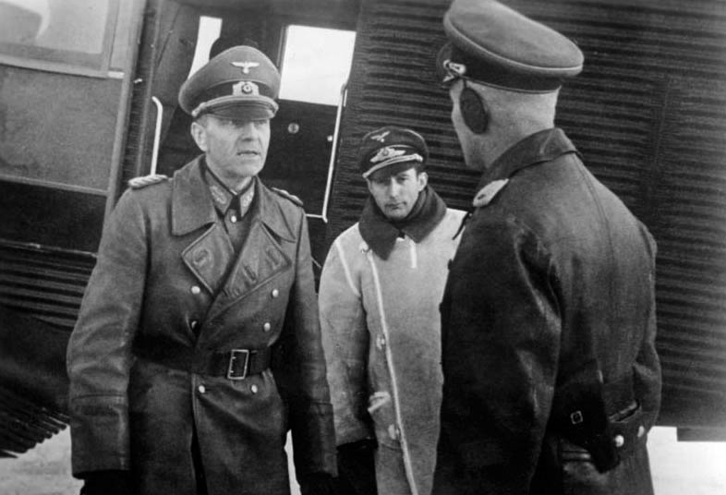
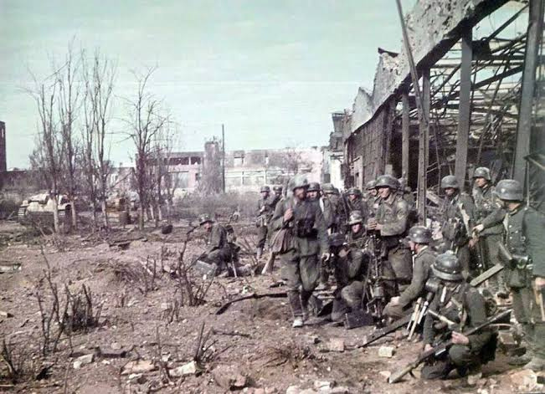
Friedrich Paulus
(marshal)
-on the left-
Wehrmacht

Slide 7
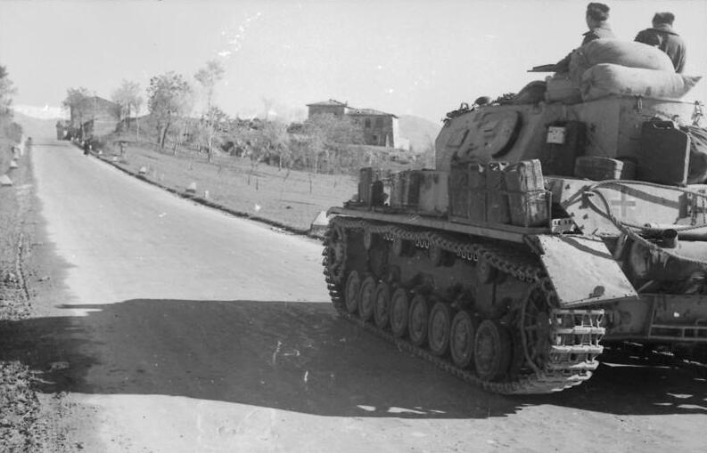
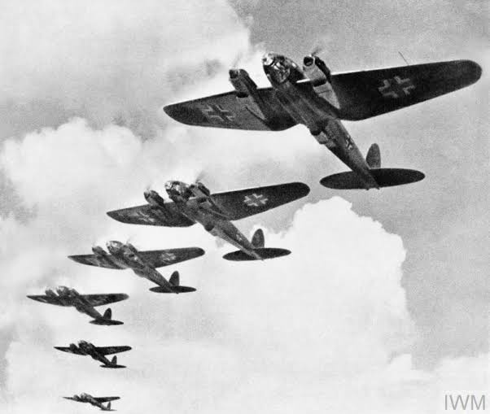
Panzer Unit
Luftwaffe

Slide 8

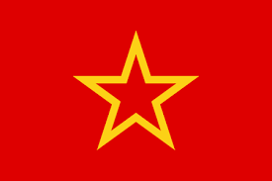
Soviet Union
Russia from the allies powers.
Josef Stalin is command of the Soviet Russia.
Russia has a the Red Army.
Most of the Red Army participated in this war.
Soviets fight alone.
The Red Army Flag

Slide 9
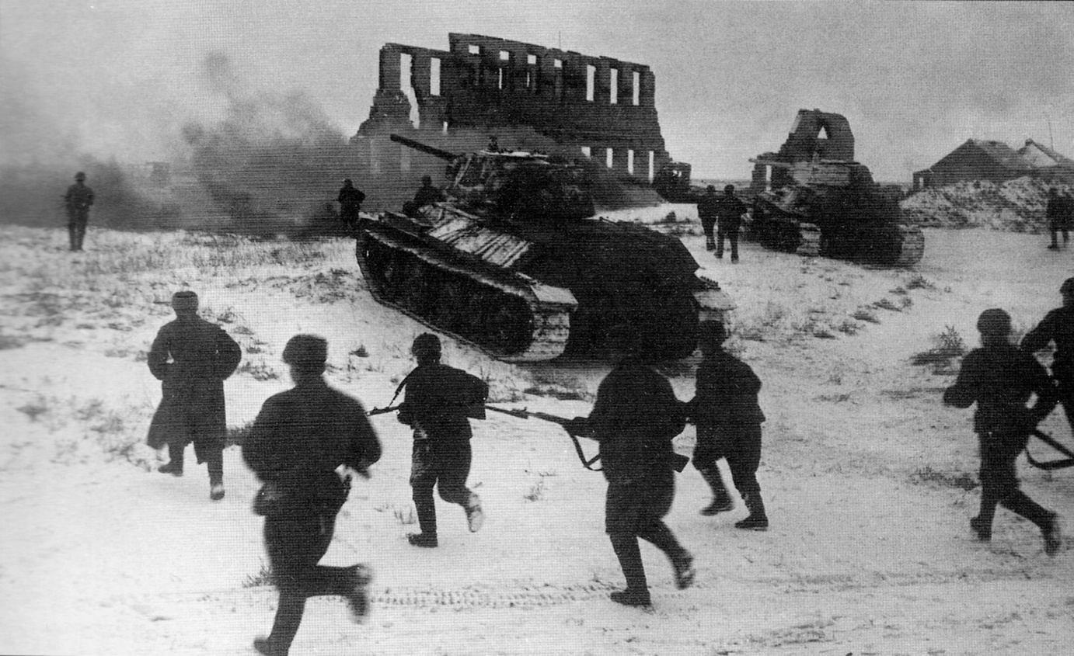
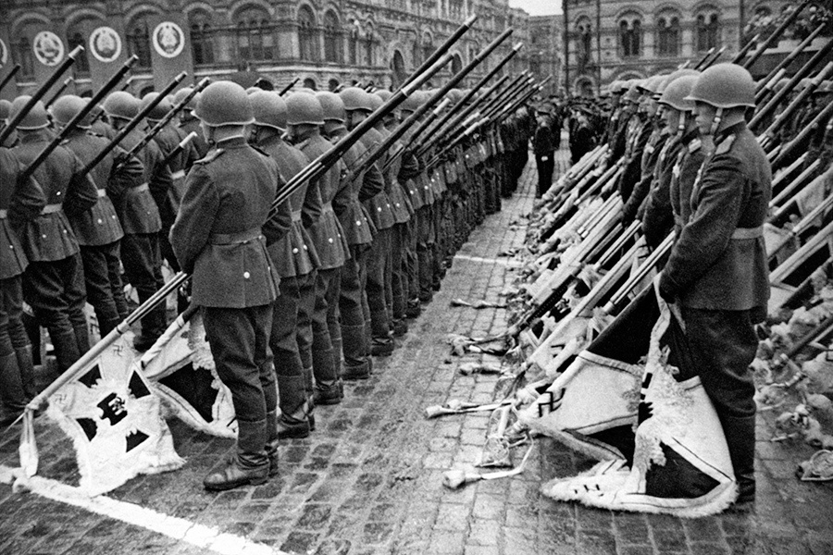
Soviet soldiers counterattack.
Soviet soldiers are waiting to throw down Nazi flags.

Slide 10
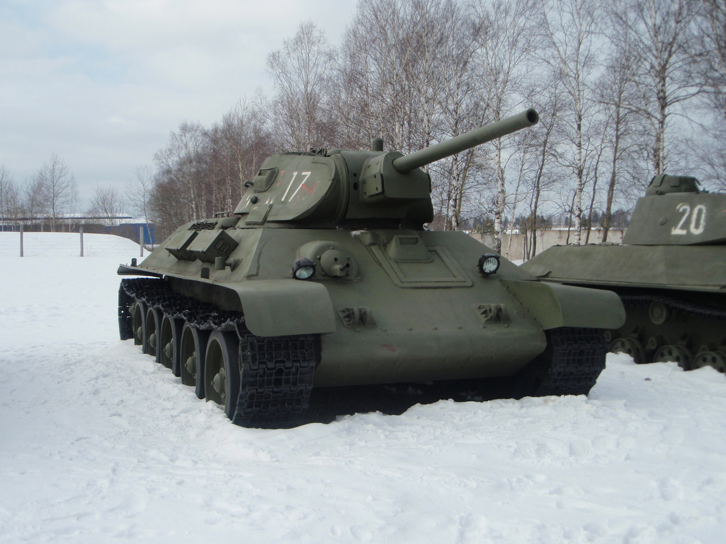
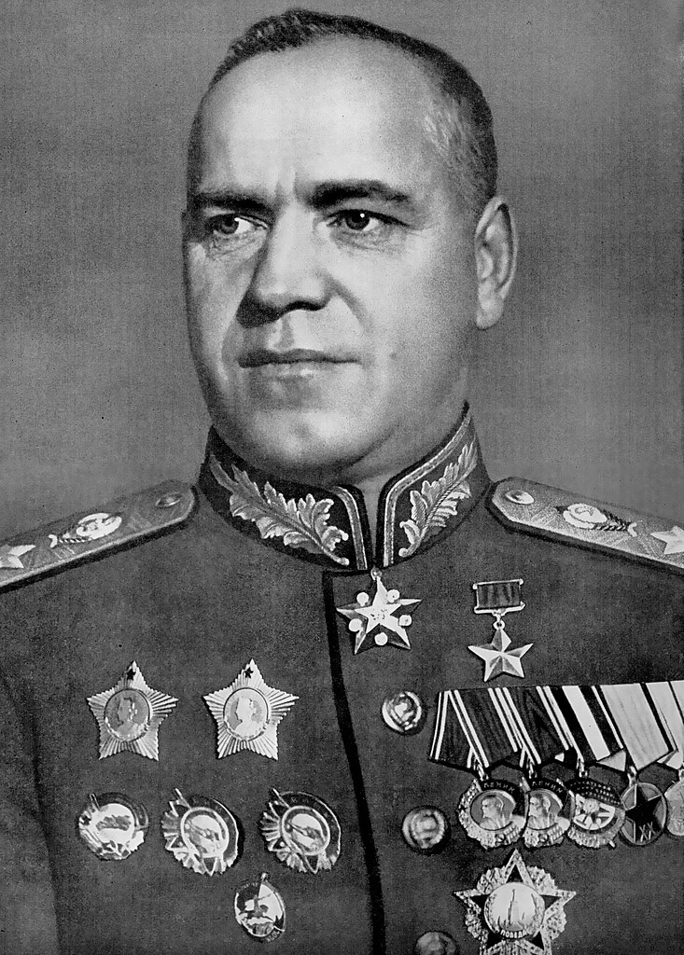
Soviet T-34 Tank
Georgi Jukov
(marshal)

Slide 11
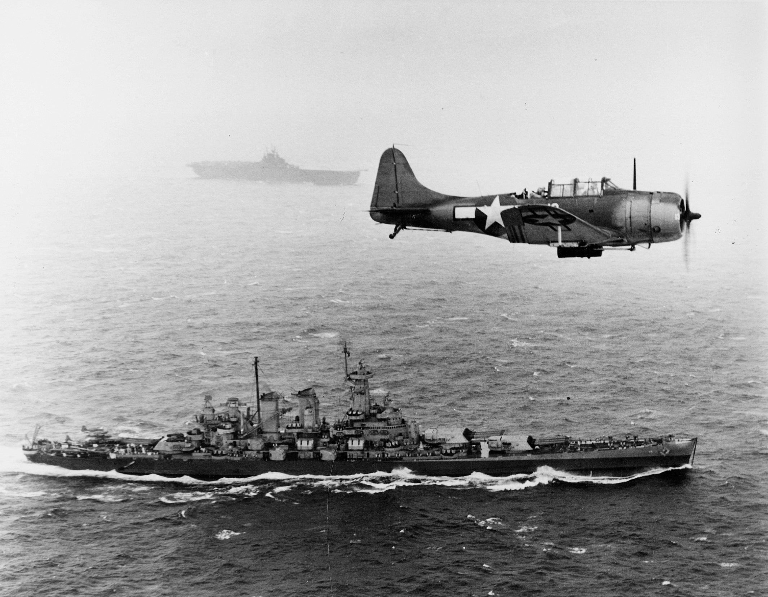
Causes of War

Slide 12
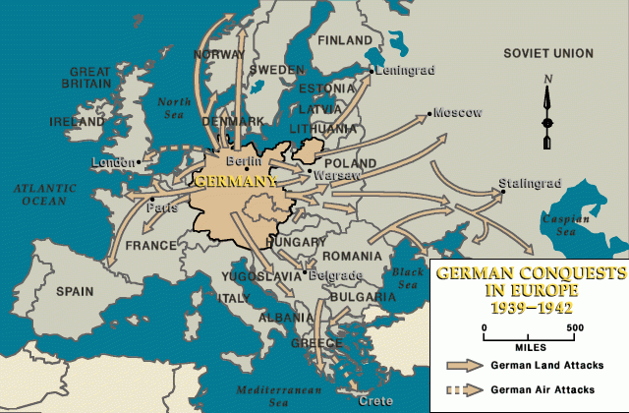
Germans want to go east.

Slide 13
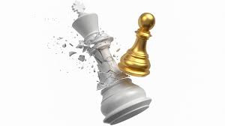
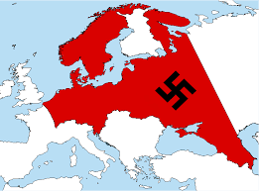
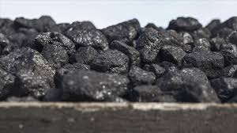
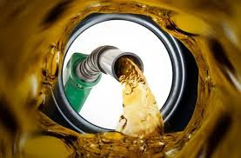
For these:
Domination
Strategy
Mine
Oil

Slide 14
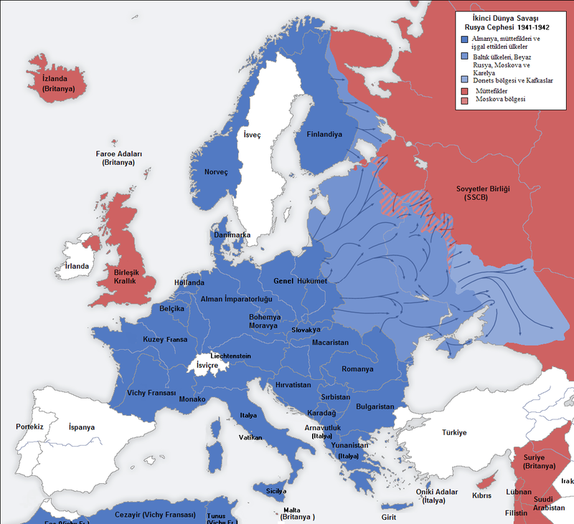
Germans want to rule the world.

Slide 15
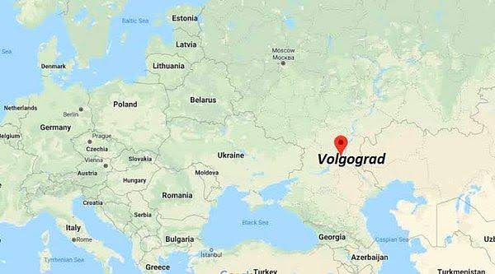
Stalingrad has a strategic location. And the gate of the Caucasus.

Slide 16
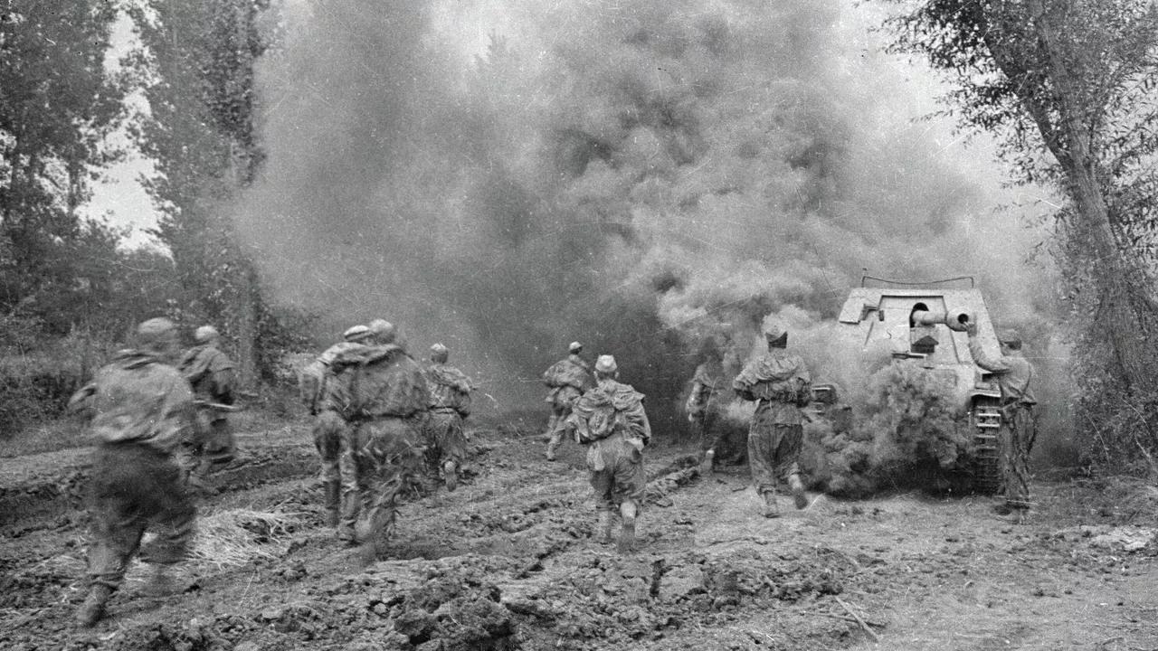
The Russians suffered many casualties in Leningrad.

Slide 17
Some Information About War
The war started in August 1942.
It took 164 days.
The battle changed the fate of the Second World War.
The war took place in very difficult conditions.
Most of the soldiers starved to death, froze to death, died of disease.
Russians blockaded the Germans in Stalingrad.
The aid coming from Moscow to the Russians changed the course of the war.

Slide 18
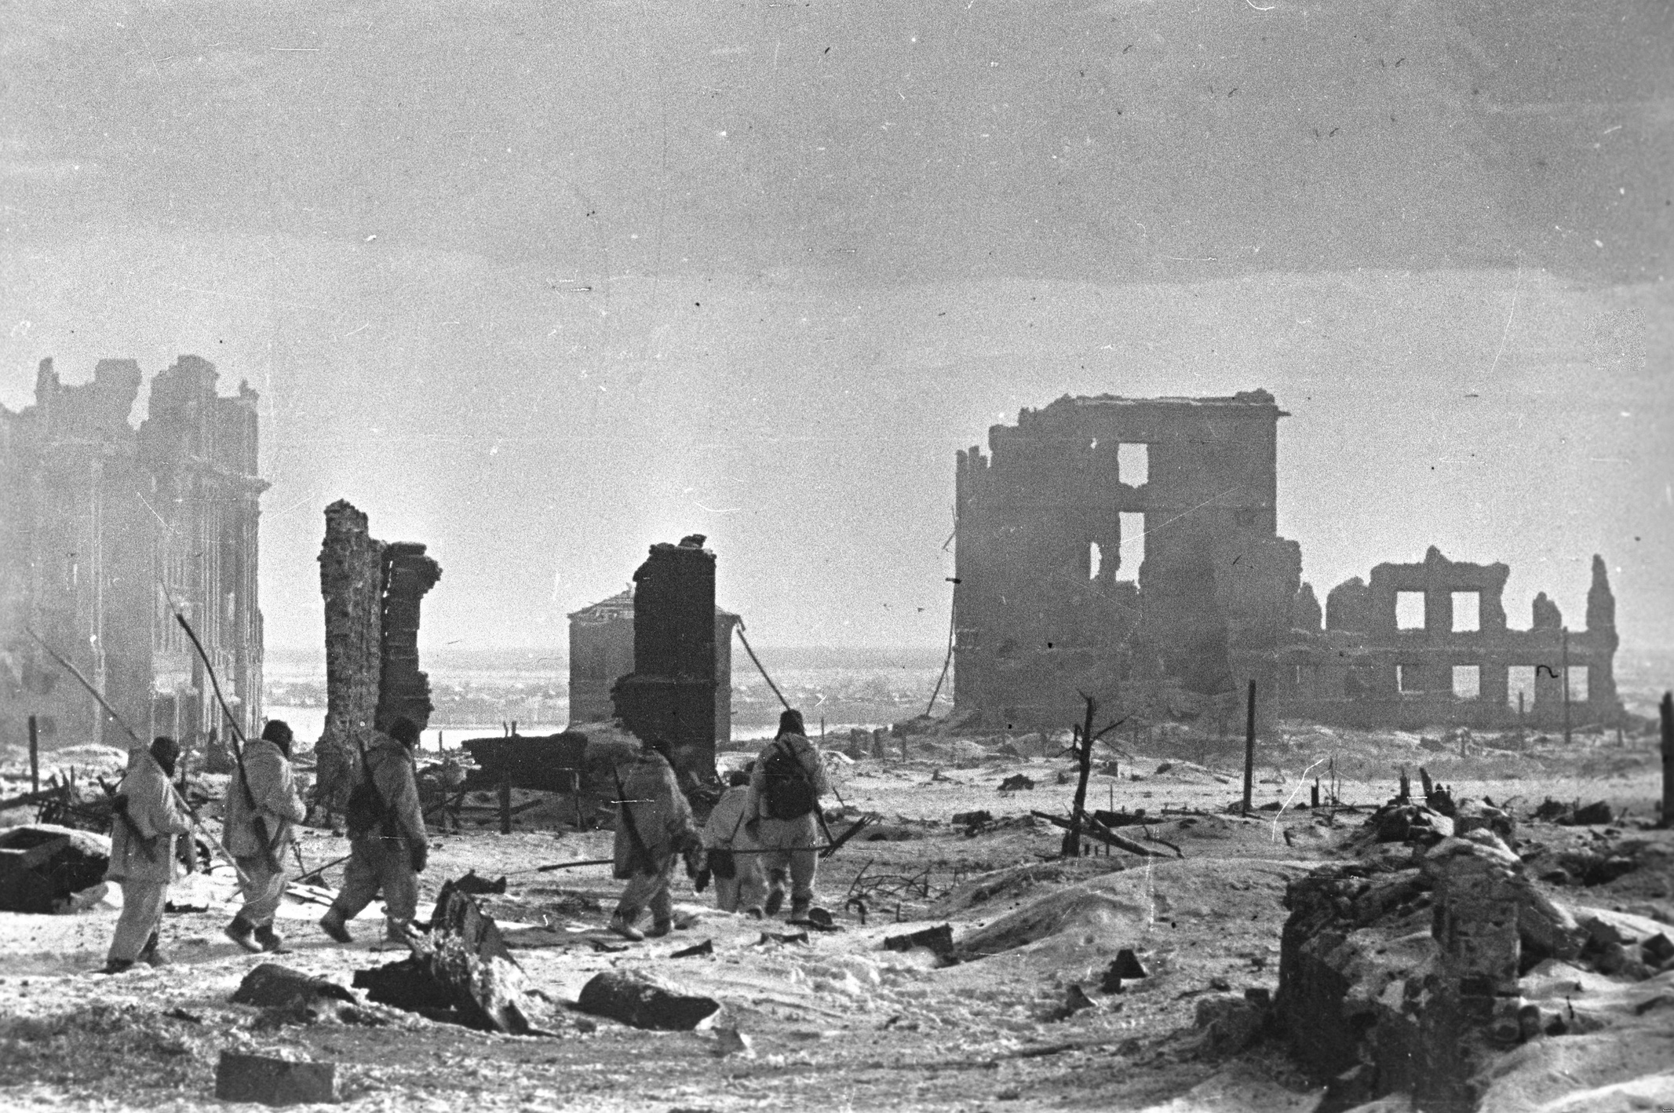
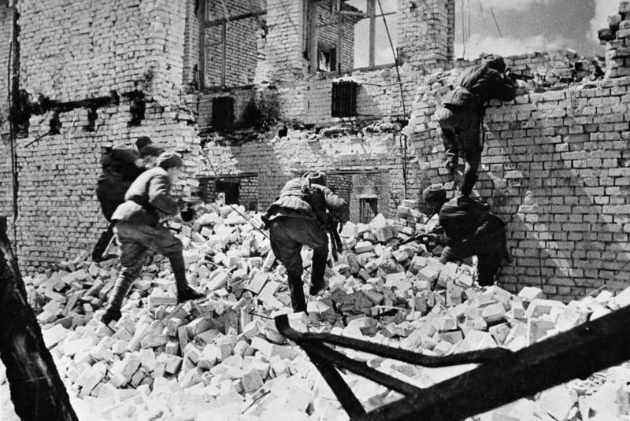
Photos from the War:
Stalingrad after the Victory.
Close-quarters combat (CQC)

Slide 19
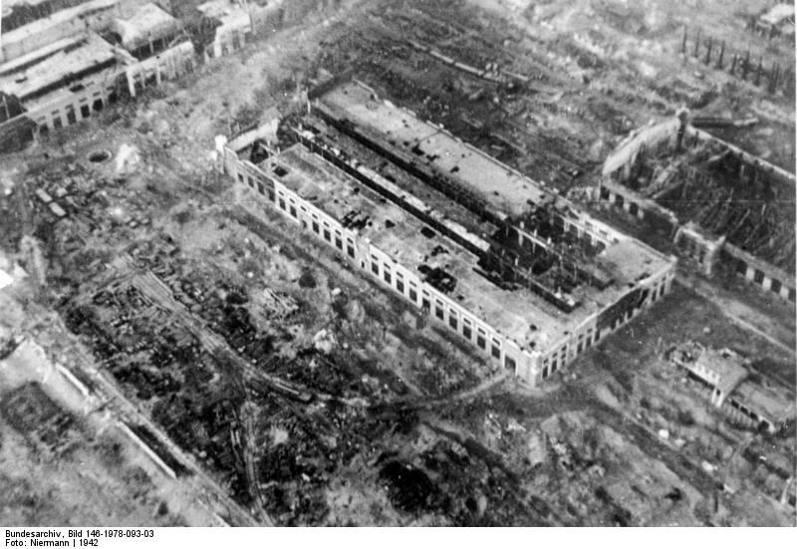
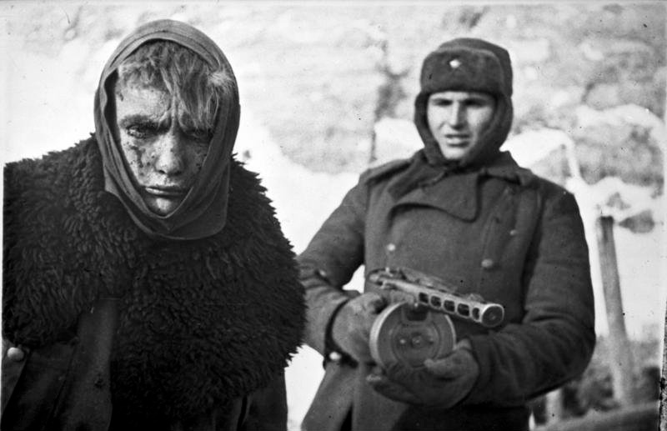
He is a captured German soldier.
After the Luftwaffe attacks.

Slide 20
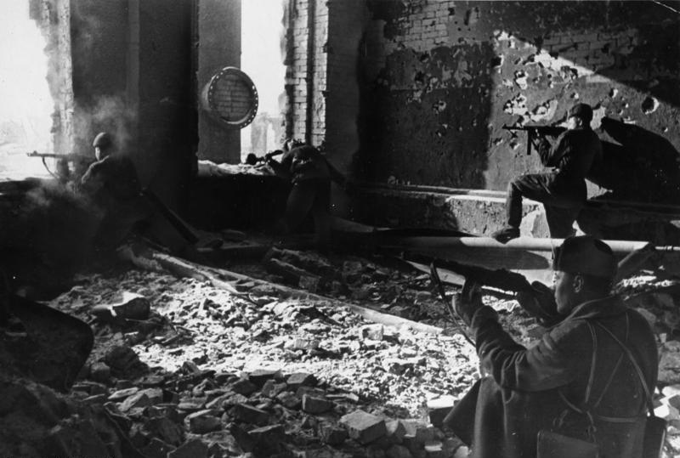
Soviet soldiers are inside the building.

Slide 21
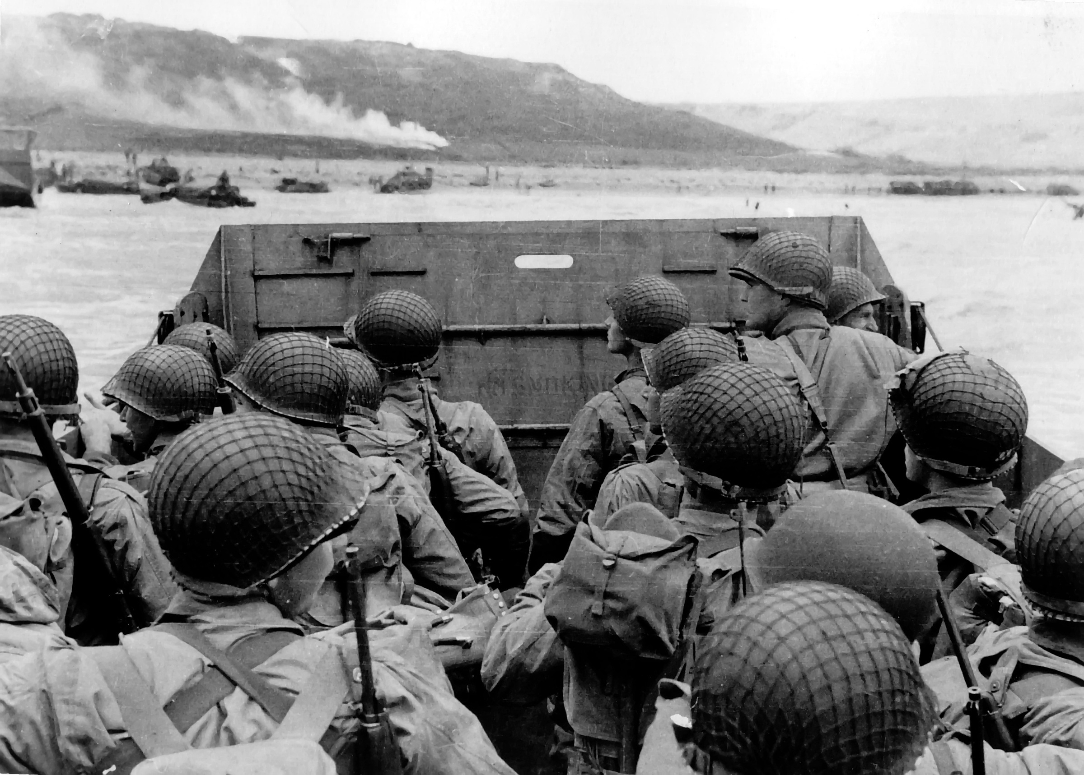
Results of War

Slide 22
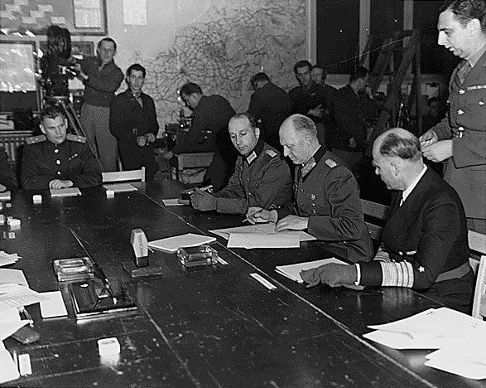
Germans were defeated.

Slide 23
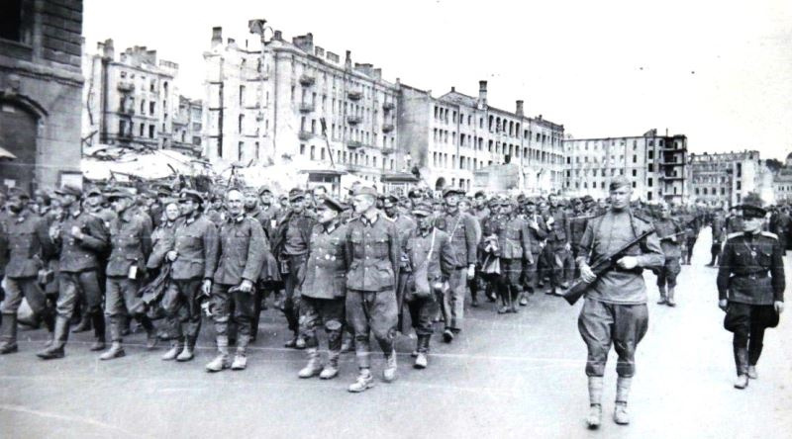
Most german soldier were taken captive.

Slide 24
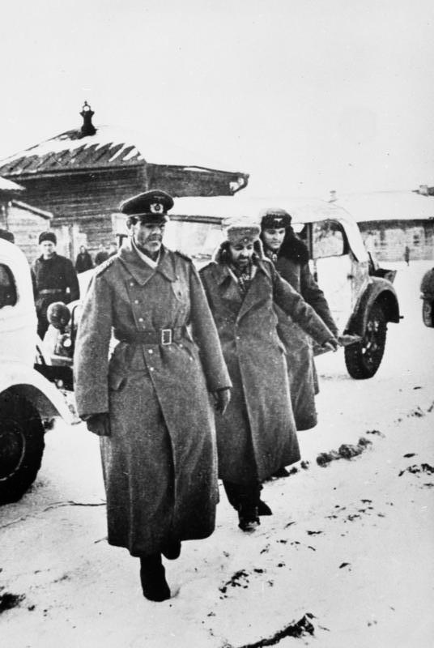
The German general surrendered.
(Friedrich Paulus)

Slide 25

6th Army flag
German 6th Army was destroyed by the Soviets.

Slide 26
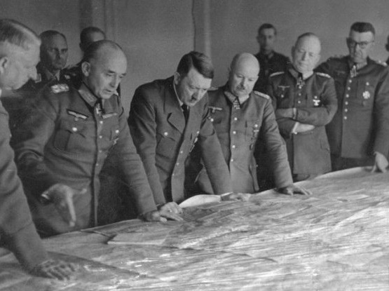
Things started to get worse for Hitler.

Slide 27
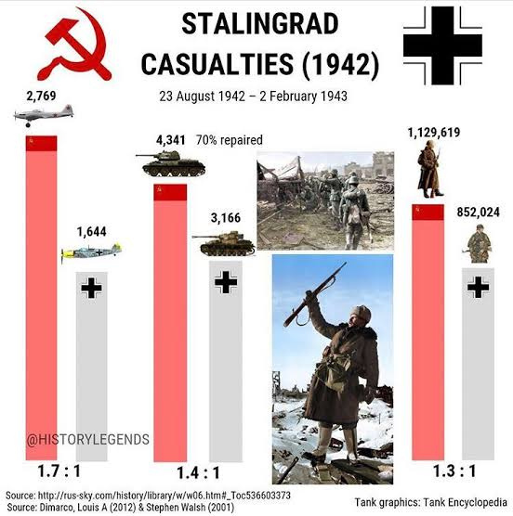
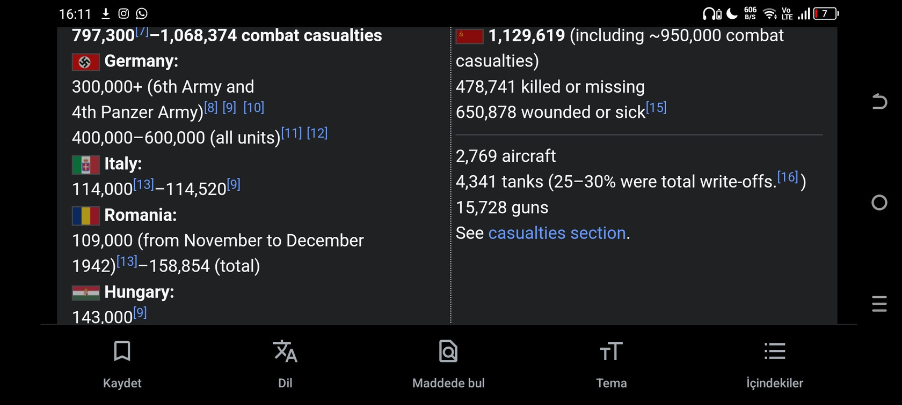
Approximately 2 million people died.

Slide 28
And Unrecorded Losses...

Slide 29
"Unless a nation’s life faces peril, war is murder."
M. Kemal Atatürk

Slide 30
Thanks for Listening
Atınç Gök

